Slide 1
AI in Hollywood
Marc Topacio CSIT 100 11/7/23

Slide 2
Table of Contents
I. Introduction
II. AI vs Writers
III. AI & Actors
IV. AI Art

Slide 3
I. INTRODUCTION
The creation of AI is a revolutionary marvel. It has done so much for humanity and has become one of mankind’s greatest achievements. Although AI has been pointing us in the right step towards the future, it surprisingly had some negative impact as a whole. Most of it being within the landscape of Hollywood.

Slide 4
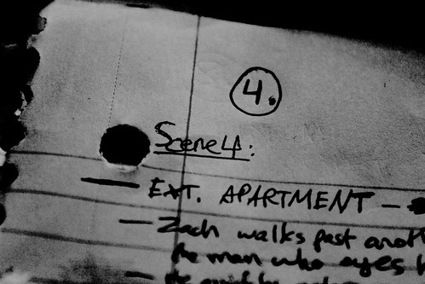
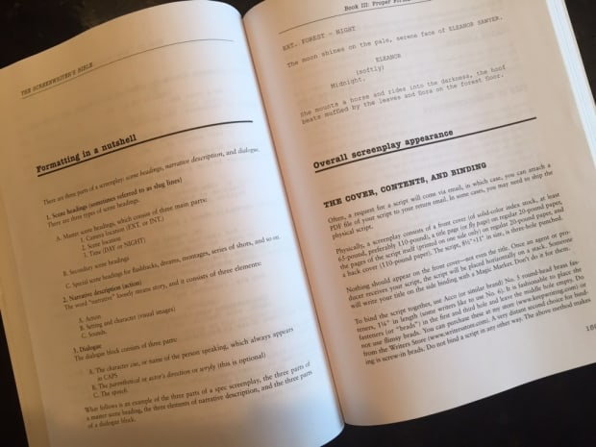
II. AI vs Writers
For many years, one of the most important parts in the making of a film is the writing team. You are not only tasked to write up the script for the whole movie but it’s up to the writers to scribe up how scenes play out, what special FX will be implemented, and what the overall tone should be.
They are an integral part of the creative process. For some, they base their opinion on a movie solely on WHO is on the writing team, especially if one or two writers have a good reputation in Hollywood.

Slide 5
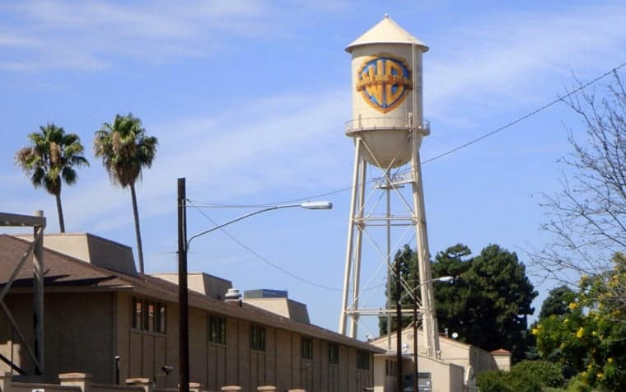
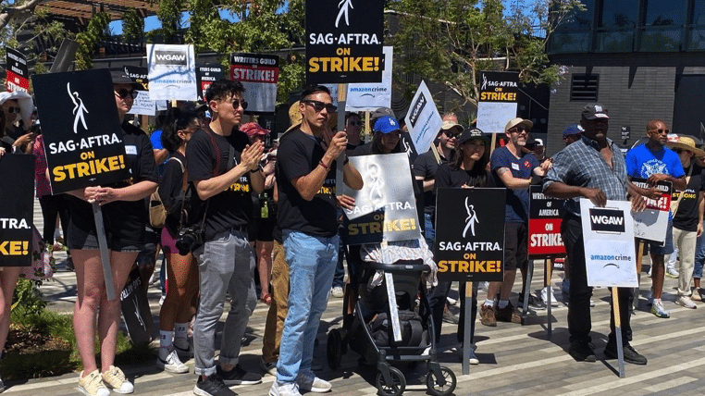
II. AI vs Writers
However, with the rise of AI, studio heads have considered outright replacing human writers with this tech.
AI has evolved so much where it is able to write perfectly good essays (Chat GPT) so why wouldn’t they use AI to generate a script? Also, studios don’t really care for the well being of the teams that are working on the movie, and only care about how much profit comes out of it. So, to them, it would actually be more efficient and less costing for them to use AI rather than to pay each writer for doing their job.
The existence of AI threatens the main purpose of the hardworking writing teams and is one of main reasons why SAG-AFTRA or WGA (Writers Guild of America) is fighting back against the integration of AI. It has gotten so bad that SAG-AFTRA had actively went on strike against the studios, which as a result, seized all production on upcoming movies.

Slide 6

II. AI vs Writers
In addition to that, many WGA members have tried to create a contract so they could at least negotiate with the studios on the use of AI and what will happen moving forward. According to an article by John Coyle on Associated Press News (AP), the contracts reads “that writers can use AI if the company consents. But a company cannot require a writer to use AI software.”
Although AI is an overall problem to the writers, the studios believe that it is too early to tackle AI so they didn’t want to negotiate anything right now. As a result, the WGA and the companies agreed to meet up at least twice a year to slowly further negotiate the terms as the legal use of AI is “uncertain and rapidly developing”, according to the article.
It’s safe to assume that both parties are still on the fence about AI but it is still ongoing so the future for writers in this landscape is still unknown.

Slide 7
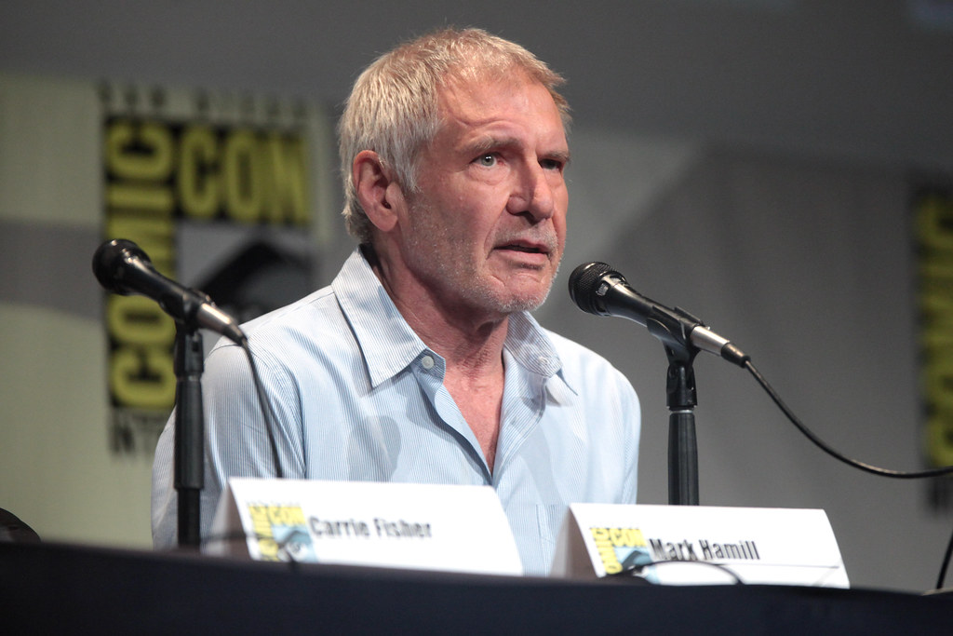
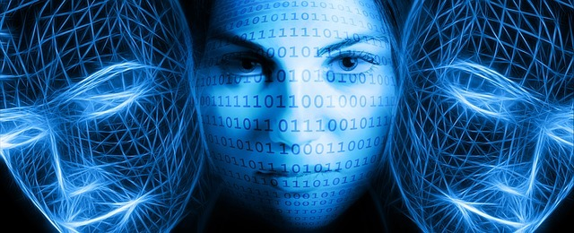
III. AI & Actors
AI replacing writers is one thing but what about competently using one’s likeness without your permission to use in a movie?
There are many beloved actors and actresses that we adore (or hate) but unfortunately, some of them aren’t getting any younger. They aren’t going to be around forever but to the studio, that is where AI comes into play….

Slide 8
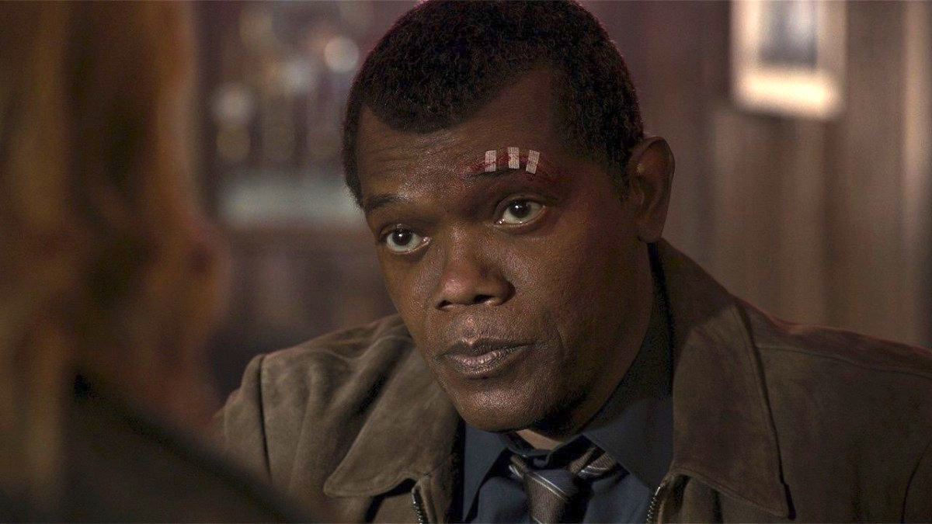
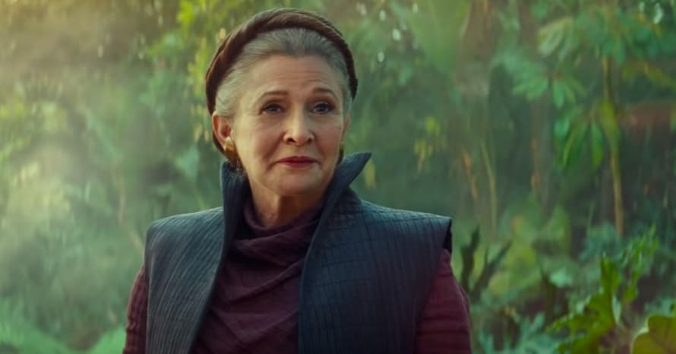
III. AI & Actors
There was one thing AI did beneficially. A few movies had a specific tech that was able to “de-age” some actors and actresses to make them look younger for plot significance. Two recent movies actually used this de-aging tech, that being Indiana Jones and the Dial of Destiny with Harrison Ford and Captain Marvel with Samuel L Jackson. There were probably some more movies that used this so, I feel this is the few times AI actually proved useful.
But much like with the writers, the strike also touched upon this as they worried that studios and companies might use AI to just use any actor or actress’s likeness for any movie, with or without permission. There is also the possibility of completely using AI to bring back deceased actors and actresses which unfortunately brings up the “ethicality” of bringing someone back from the dead to generate buzz for a movie, which is a whole different conversation.

Slide 9
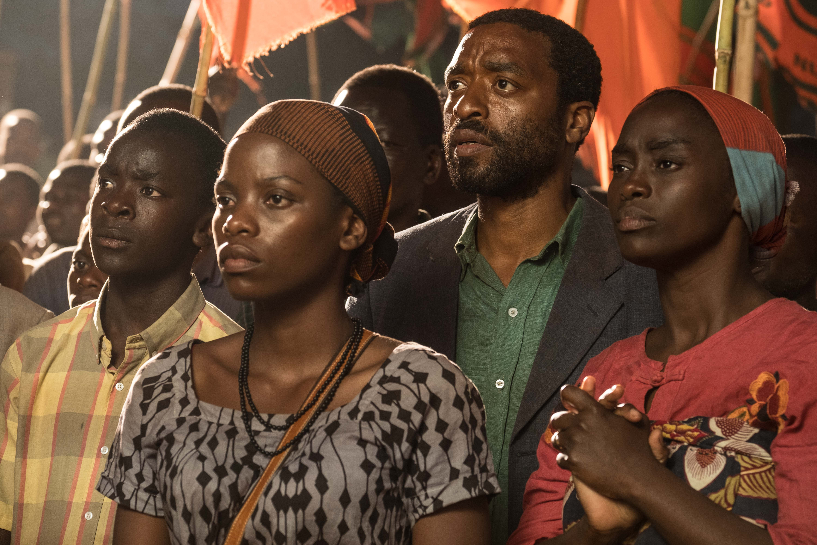
III. AI & Actors
I feel the worst thing that came out of the integration of AI is its use for background characters. Normally, you’d have hire many people to pose as background characters for pretty much any movie that requires a crowd. Now, with today’s technology, you can simply construct a crowd using AI. Studios no longer need to hire as many people as possible anymore or pay them all individually for it when you can replace them all with AI.
Luckily, we haven’t many movies integrate AI specifically for this reason, but it is an option for the studios to do and that is quite scary to think about.

Slide 10
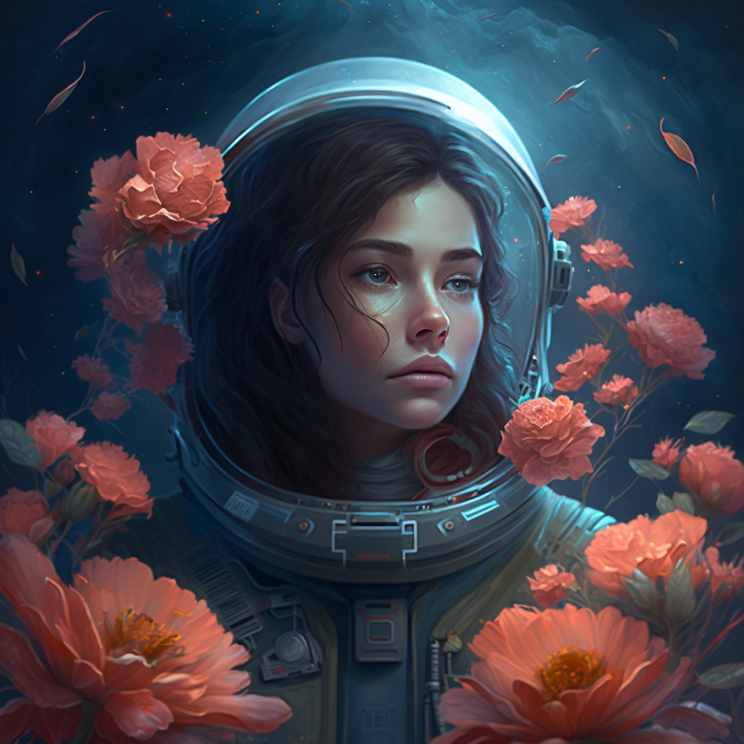
IV. AI Art
Finally, while not too related to Hollywood but has become an issue recently, AI has found its way into the realm of digital art. As a digital artist myself, it’s rather sad to see some people resort to AI to make digital art and call it their own. Since AI is always evolving, it’s only going to get smarter and smarter, with more specific prompts being possible to create more “authentic” art. With the rise of AI art, it will continue to be a major problem in the digital art community.

Slide 11

IV. AI Art
While AI Art hasn’t shown up in many Hollywood movies, there was a Disney+ show that used AI to create its opening credits: Secret Invasions. And this rubbed many people the wrong way because of this. According to Ali Salim, who is the director and executive producer of the show, he explained that the reason AI was used was because it just fit the overall theme of the show: “When we reached out to the AI vendors, that was part of it — it just came right out of the shape-shifting, Skrull world identity, you know? Who did this? Who is this?” I guess the “shapeshifting” of the art perfectly reflects the show’s theme and gives off a sense of mystery.
While I can get behind the use of AI art as a creative choice, it still doesn’t leave a good impression and seeing this is Disney, it’s scary to think about what Disney or any Hollywood studio could do with AI art.

Slide 12
Conclusion
Overall, the technological achievements of AI cannot be understated. We will continue to evolve the AI technology so that we may construct a better future for society, with AI pushing towards goals we never thought was possible due to mankind’s own limitations. However, this comes at a price. Many people have gotten more lazier and are not developing the proper skills needed.
Hollywood isn’t getting any better either as the rise of AI is looming over people who are writers, artists, and even actors. It is threatening the careers of these writers and artists, and we might live in a world where AI fills these job opportunities instead of people with actual skill and talent.
We are headed towards the future, but it doesn’t seem as bright as you think, especially if one works for Hollywood.

